Slide 1
Jersey + Swagger
RESTful API in AEM

Slide 2
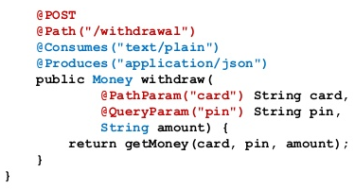
Goals and References
JAX-RS Server https://jax-rs-spec.java.net/
Jackson JSON-POJO mapper: https://github.com/FasterXML/jackson
Swagger yaml/json definition http://petstore.swagger.io/v2/swagger.json
Swagger UI visual forms http://petstore.swagger.io/

Slide 3
Dependencies
<dependency>
<groupId>com.eclipsesource.jaxrs</groupId>
<artifactId>jersey-all</artifactId>
</dependency>
<dependency>
<groupId>com.eclipsesource.jaxrs</groupId>
<artifactId>publisher</artifactId>
</dependency>
<dependency>
<groupId>com.fasterxml.jackson.jaxrs</groupId>
<artifactId>jackson-jaxrs-json-provider</artifactId>
</dependency>
<dependency>
<groupId>com.eclipsesource.jaxrs</groupId>
<artifactId>swagger-all</artifactId>
</dependency>

Slide 4
Bundles
<embedded>
<groupId>com.eclipsesource.jaxrs</groupId>
<artifactId>jersey-all</artifactId>
<target>${install.path}</target>
</embedded>
<embedded>
<groupId>com.eclipsesource.jaxrs</groupId>
<artifactId>swagger-all</artifactId>
<target>${install.path}</target>
</embedded>
<embedded>
<groupId>com.eclipsesource.jaxrs</groupId>
<artifactId>publisher</artifactId>
<target>${install.path}</target>
</embedded>

Slide 5
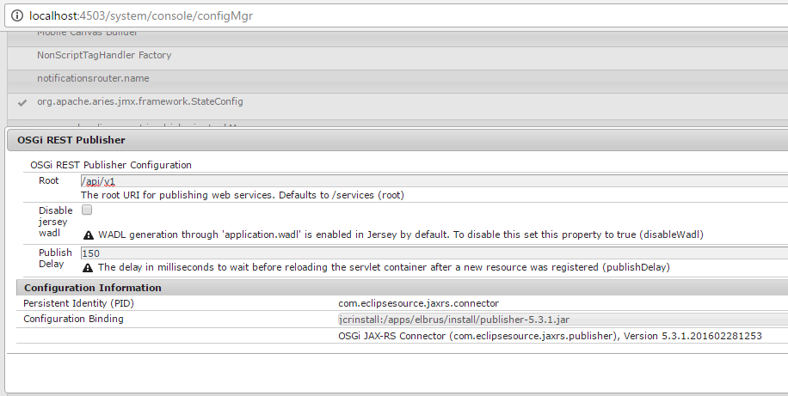
Configuration

Slide 6
Jersey via Jackson
Jackson JSON marshaller/parser.
POJOs with optional annotations.
Resource classes.

Slide 7
JSON Provider
@Component
@Service(Object.class)
@Property(name = "javax.ws.rs", boolValue = true)
@Consumes(MediaType.WILDCARD)
@Produces(MediaType.WILDCARD)
@Provider
public class JsonProvider extends JacksonJaxbJsonProvider {}

Slide 8
Data model
public class Company {
private final int id;
@JsonProperty("company name")
private final String name;
public Company(int id, String name) {
this.id = id;
this.name = name;
}
public int getId() { return id; }
public String getName() { return name; }
}

Slide 9
Resource class
@Path("/company")
@Consumes(MediaType.APPLICATION_JSON)
@Produces(MediaType.APPLICATION_JSON)
public class CompanyResource {
@GET
public List<Company> list() {
return service.selectNewCompanies();
}
@POST
public int create(Company company) throws NotAuthorizedException {
return service.createNewCompany(company);
}
}

Slide 10
Swagger
Resource and operations annotations.
Model and properties annotations.
JSON/YAML definition lister.
Swagger UI.

Slide 11
Resource and operation annotations
@Api("Company resource")
public class CompanyResource {
@GET
@ApiOperation("Returns all companies")
public List<Company> all() {
return ImmutableList.of(new Company(1, "Axamit"),
new Company(2, "Adobe"),
new Company(3, "Oracle"));
}
}

Slide 12
Model and properties annotations
@ApiModel("Company model")
public class Company {
@ApiModelProperty("Company ID")
private final int id;
@ApiModelProperty("Company Name")
private final String name;
public Company(int id, String name) {
this.id = id;
this.name = name;
}
public int getId() { return id; }
public String getName() { return name; }
}

Slide 13
Definition lister
@Api("Swagger lister")
@SwaggerDefinition(basePath = "/api/v1")
@Component
@Service(Object.class)
@Path("/")
public class SwaggerResource extends ApiListingResource {}

Slide 14
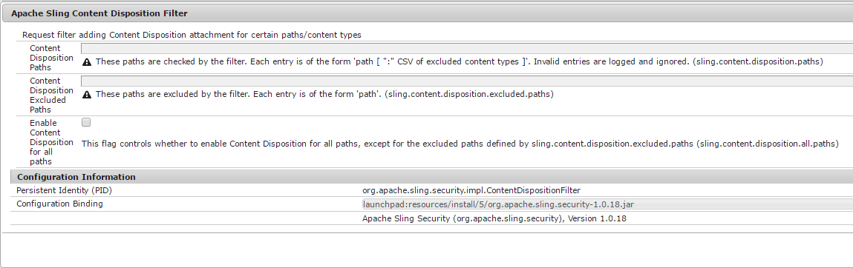
Swagger UI
https://github.com/swagger-api/swagger-ui/tree/master/dist -> /etc/designs/elbrus/swagger/

Slide 15
Questions?
Author: Vasily Lazerko
Company: Axamit

